Slide 1


SMART INDIA HACKATHON 2024
SECUREVOTE
PS Category - Software
Team ID – PCS25-57
Team Name - SecureVote

Slide 2
SecureVote – Problem Statement
The current voting system in India faces significant challenges that undermine the efficiency of elections.
These problems include registration of fake and illegal voter identity cards, the vulnerability of (EVMs) to tampering and hacking, less participation, and excessive money use.

Slide 3
SecureVote – Proposed Solution
We present you an innovative solution that seeks to revolutionize the electoral process - Secure Vote
This Blockchain-based system combines the principles of transparency, immutability, and security to ensure the integrity of every vote casted.

Slide 4
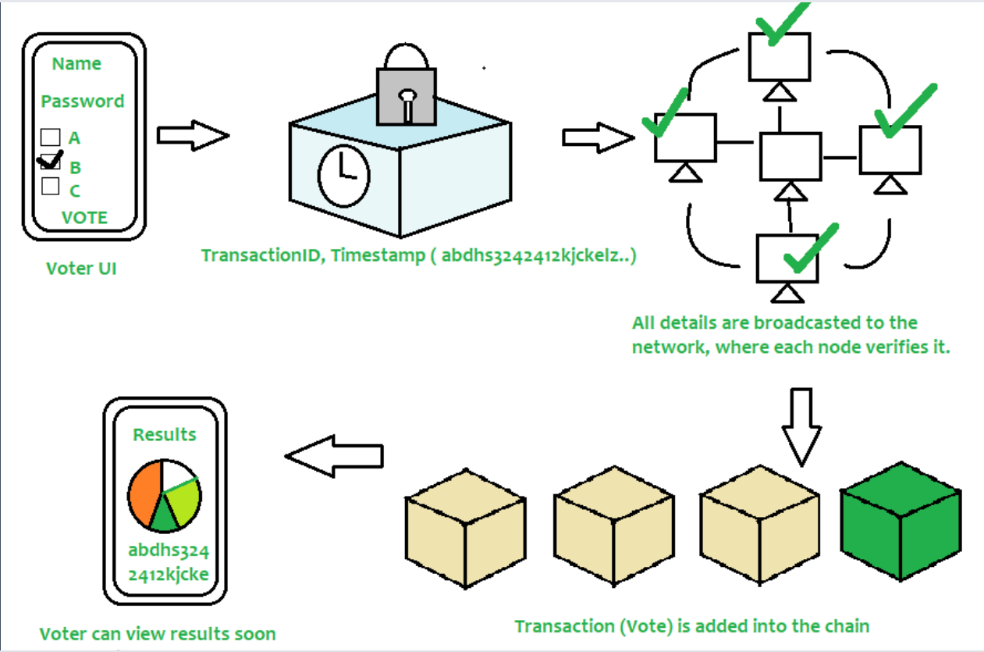
SecureVote – Technical Approach

Slide 5
SecureVote – Feasibility
This solution can be implemented on a network of EVM grid, utilizing the different EVM machines as a potential node.
Another use-case can be remote voting directly from phones/computers, in case the voter cannot come directly to the polling booth.

Slide 6
SecureVote – Impact
Infiltration of fake and illegal voter identity cards can be reduced.
Vulnerability of Electronic Voting Machines (EVMs) to Tampering and Hacking will be minimized.
Participation in the voting will increase as voting becomes more accessible.
Financial Burden on Taxpayers might be reduced.

